Slide 1
PRINCIPLES OF MARKETING / 04A

Slide 2
STRATEGIC MARKETING PLANNING
About strategy

Slide 3
STRATEGIC MARKETING PLANNING
About strategy

Slide 4
STRATEGIC MARKETING PLANNING
About strategy

Slide 5
STRATEGIC MARKETING PLANNING
About strategy

Slide 6
STRATEGIC MARKETING PLANNING
About strategy

Slide 7
STRATEGIC MARKETING PLANNING
(Marketing) planning cycle

Slide 8
STRATEGIC MARKETING PLANNING
(Marketing) planning cycle

Slide 9
STRATEGIC MARKETING PLANNING
(Marketing) planning cycle

Slide 10
STRATEGIC MARKETING PLANNING
(Marketing) planning cycle

Slide 11
STRATEGIC MARKETING PLANNING

Slide 12
STRATEGIC MARKETING PLANNING
Strategy, aspects

Slide 13
STRATEGIC MARKETING PLANNING
Strategy, aspects

Slide 14
STRATEGIC MARKETING PLANNING
Strategy, aspects

Slide 15
STRATEGIC MARKETING PLANNING
Common business objectives

Slide 16
STRATEGIC MARKETING PLANNING
A major decision: the PMC

Slide 17
STRATEGIC MARKETING PLANNING
The mission of the organization

Slide 18
STRATEGIC MARKETING PLANNING
The mission of the organization

Slide 19
STRATEGIC MARKETING PLANNING
The mission of the organization

Slide 20
STRATEGIC MARKETING PLANNING
The mission of the organization

Slide 21
STRATEGIC MARKETING PLANNING
The mission of the organization

Slide 22
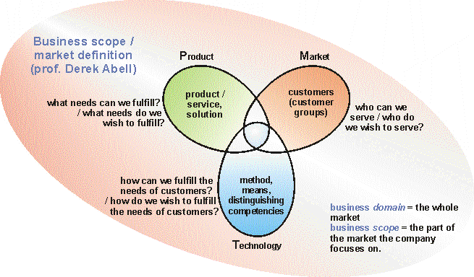
STRATEGIC MARKETING PLANNING
From mission to business scope: the PMT

Slide 23
STRATEGIC MARKETING PLANNING
From mission to business scope: the PMT

Slide 24
STRATEGIC MARKETING PLANNING
Strategy formulation, in detail (1)

Slide 25
STRATEGIC MARKETING PLANNING
Strategy formulation, in detail (2)

Slide 26
STRATEGIC MARKETING PLANNING
Strategy formulation, a continuous cycle

Slide 27
STRATEGIC MARKETING PLANNING
Analysis of current strategy / situation

Slide 28
STRATEGIC MARKETING PLANNING
Forecast current strategy: strategic gap

Slide 29
STRATEGIC MARKETING PLANNING
Forecast current strategy: strategic gap

Slide 30
STRATEGIC MARKETING PLANNING

Slide 31
STRATEGIC MARKETING PLANNING
External analysis, aspects

Slide 32
STRATEGIC MARKETING PLANNING
External analysis, aspects

Slide 33
STRATEGIC MARKETING PLANNING
External analysis, aspects

Slide 34
STRATEGIC MARKETING PLANNING
Customer analysis, trends, developments

Slide 35
STRATEGIC MARKETING PLANNING
Customer analysis, trends, developments

Slide 36
STRATEGIC MARKETING PLANNING
Customer analysis, trends, developments

Slide 37
STRATEGIC MARKETING PLANNING
Components of competition

Slide 38
STRATEGIC MARKETING PLANNING
Components of competition

Slide 39
STRATEGIC MARKETING PLANNING
Components of competition

Slide 40
STRATEGIC MARKETING PLANNING
Components of competition

Slide 41
STRATEGIC MARKETING PLANNING
Components of competition

Slide 42
STRATEGIC MARKETING PLANNING
Competitior analysis

Slide 43
STRATEGIC MARKETING PLANNING
Competitior analysis

Slide 44
STRATEGIC MARKETING PLANNING
Competitior analysis

Slide 45
STRATEGIC MARKETING PLANNING
Developments regarding distribution

