Slide 1
ONLINE MARKETING / 09

Slide 2


Slide 3
ONLINE MARKETING / 09
E-mailmarketing

Slide 4
ONLINE MARKETING / 09
E-mailmarketing

Slide 5
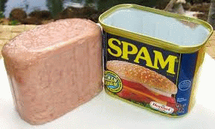
ONLINE MARKETING / 09
E-mailmarketing

Slide 6
ONLINE MARKETING / 09
E-mailmarketing

Slide 7
ONLINE MARKETING / 09
E-mailmarketing

Slide 8


Slide 9
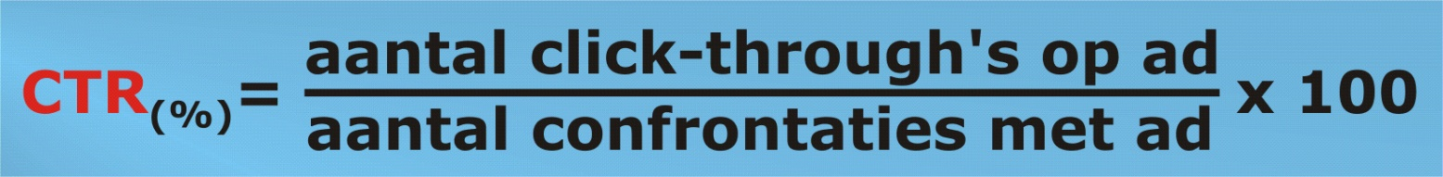
ONLINE MARKETING / 09
E-mailmarketing

Slide 10
ONLINE MARKETING / 09
E-mailmarketing

Slide 11
ONLINE MARKETING / 09
E-mailmarketing

Slide 12
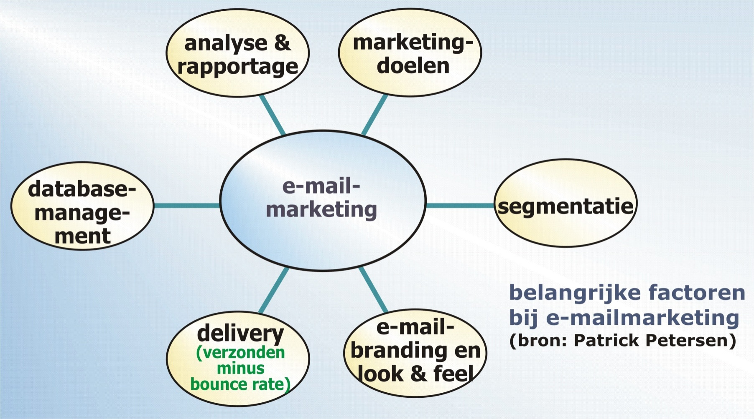
ONLINE MARKETING / 09
E-mailmarketing

Slide 13
ONLINE MARKETING / 09
E-mailmarketing

Slide 14
ONLINE MARKETING / 09
E-mailmarketing

Slide 15
ONLINE MARKETING / 09
E-mailmarketing

Slide 16
ONLINE MARKETING / 09
E-mailmarketing

Slide 17
ONLINE MARKETING / 09
E-mailmarketing

Slide 18


Slide 19
ONLINE MARKETING / 09
E-mailmarketing

Slide 20

ONLINE MARKETING / 09
E-mailmarketing

Slide 21
ONLINE MARKETING / 09
E-mailmarketing

Slide 22
ONLINE MARKETING / 09
E-mailmarketing

Slide 23
ONLINE MARKETING / 09
E-mailmarketing

Slide 24
ONLINE MARKETING / 09
E-mailmarketing

Slide 25

ONLINE MARKETING / 09
E-mailmarketing

Slide 26
ONLINE MARKETING / 09
E-mailmarketing

Slide 27
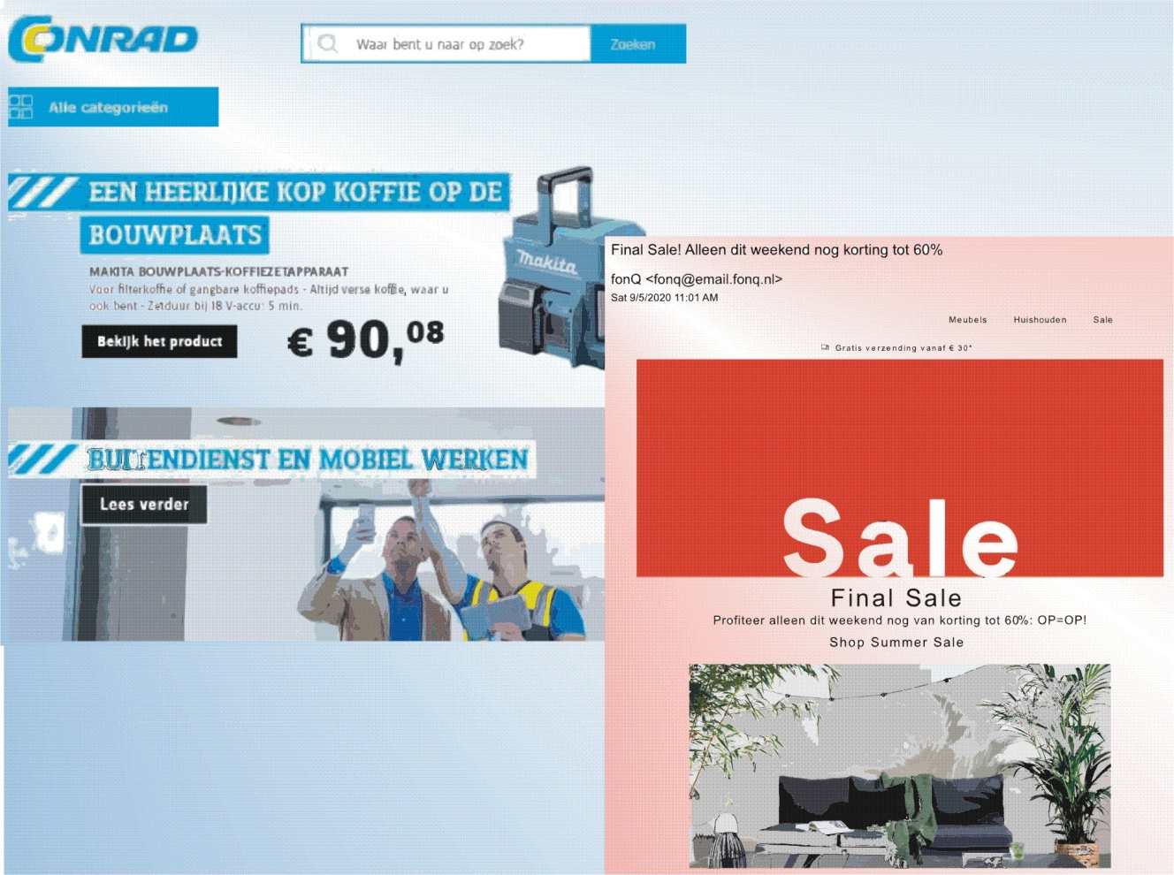
ONLINE MARKETING / 09
E-mailmarketing

Slide 28
ONLINE MARKETING / 09
E-mailmarketing

Slide 29
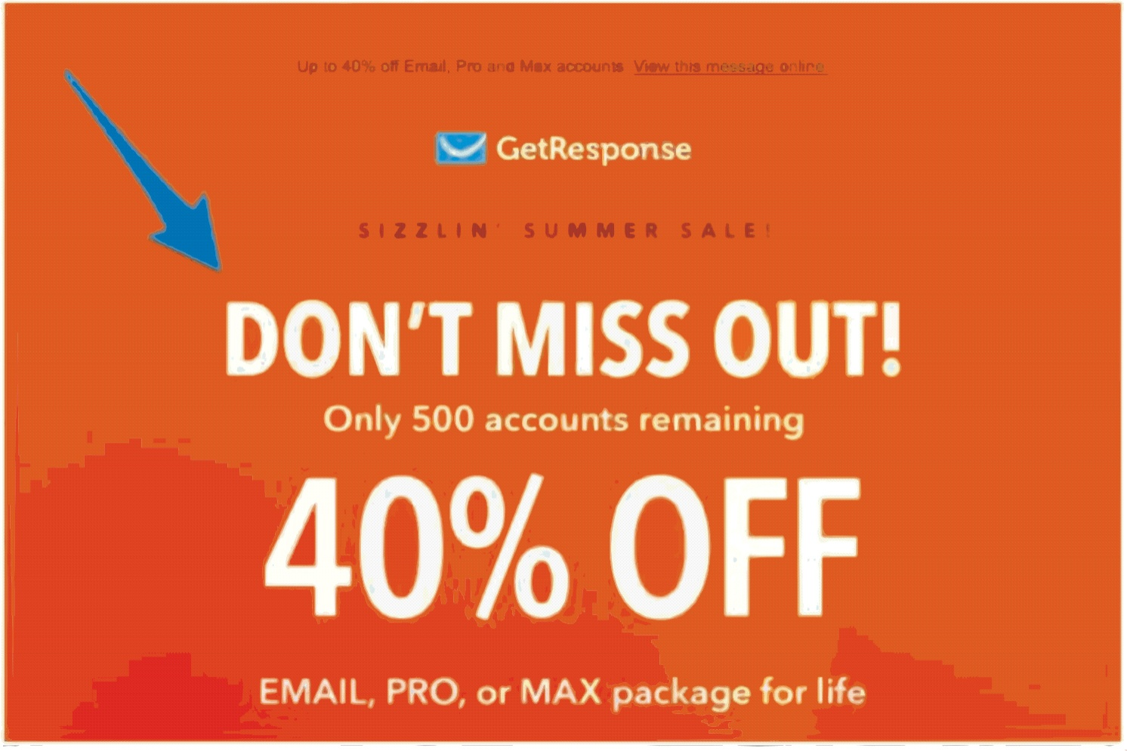
ONLINE MARKETING / 09
E-mailmarketing

Slide 30
ONLINE MARKETING / 09
E-mailmarketing

Slide 31


Slide 32
ONLINE MARKETING / 09
E-mailmarketing

Slide 33
ONLINE MARKETING / 09
E-mailmarketing

Slide 34
ONLINE MARKETING / 09
E-mailmarketing

Slide 35
ONLINE MARKETING / 09
E-mailmarketing

Slide 36
ONLINE MARKETING / 09
E-mailmarketing

Slide 37
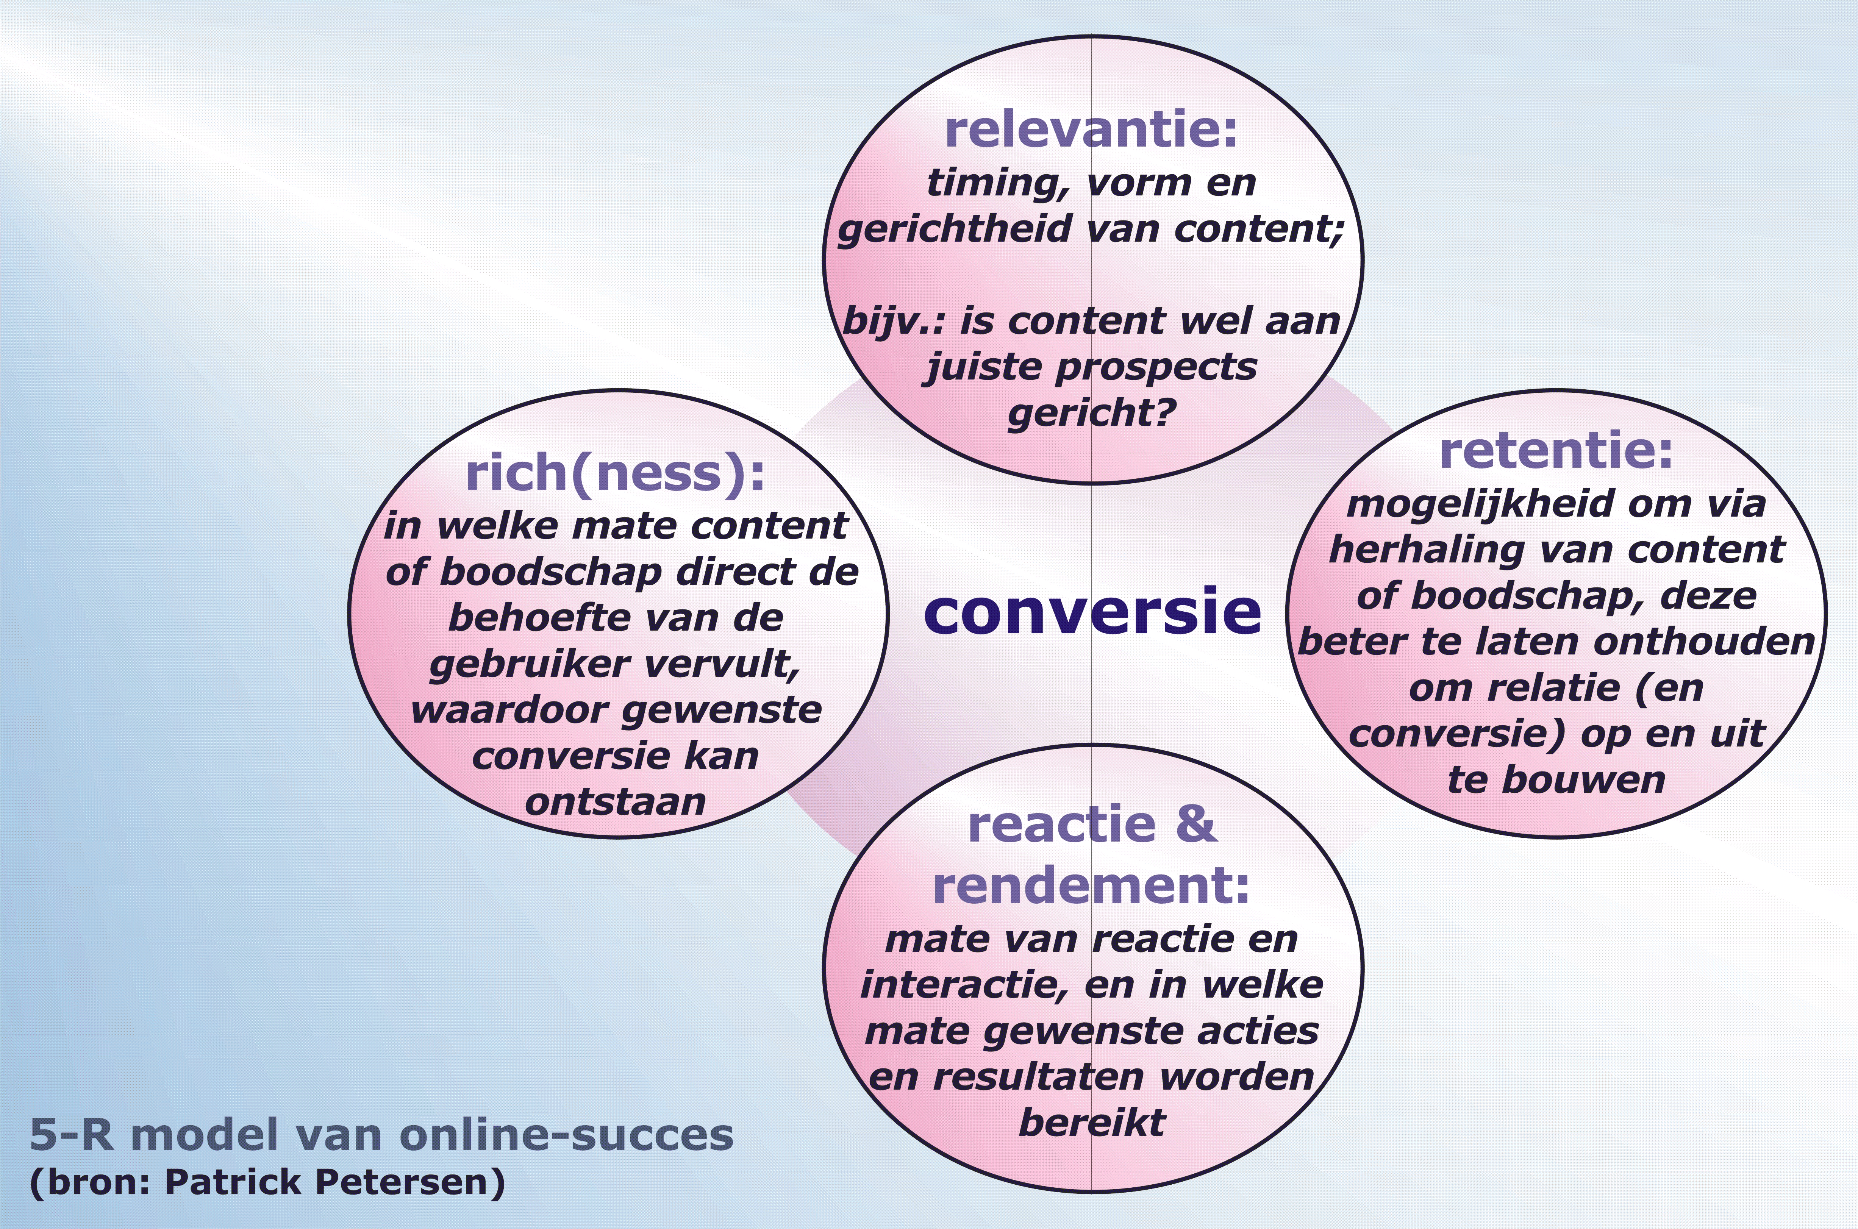
ONLINE MARKETING / 09
E-mailmarketing

Slide 38
ONLINE MARKETING / 09
E-mailmarketing

Slide 39
ONLINE MARKETING / 09
E-mailmarketing

